Slide 1


Chapter 13
Statistics
*© 2008 Pearson Addison-Wesley.
All rights reserved

Slide 2
Chapter 13: Statistics
13.1 Visual Displays of Data
13.2 Measures of Central Tendency
13.3 Measures of Dispersion
13.4 Measures of Position
13.5 The Normal Distribution
13.6 Regression and Correlation

Slide 3

Chapter 1
Chapter 1
Section 13-4
Measures of Position

Slide 4

Measures of Position
The z-Score
Percentiles
Deciles and Quartiles
The Box Plot

Slide 5
Measures of Position
In some cases we are interested in certain individual items in the data set, rather than in the set as a whole. We need a way of measuring how an item fits into the collection, how it compares to other items in the collection, or even how it compares to another item in another collection. There are several common ways of creating such measures and they are usually called measures of position.

Slide 6

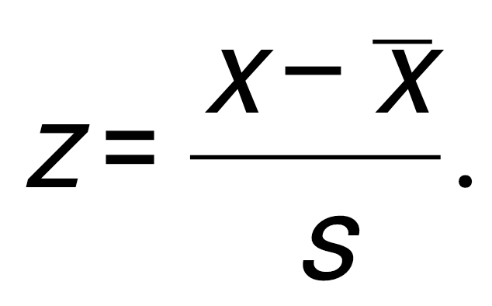
The z-Score
If x is a data item in a sample with mean and standard deviation s, then the z-score of x is given by

Slide 7
Example: Comparing with z-Scores
Two students, who take different history classes, had exams on the same day. Jen’s score was 83 while Joy’s score was 78. Which student did relatively better, given the class data shown below?
 | Jen | Joy
Class mean | 78 | 70
Class standard deviation | 4 | 5

Slide 8

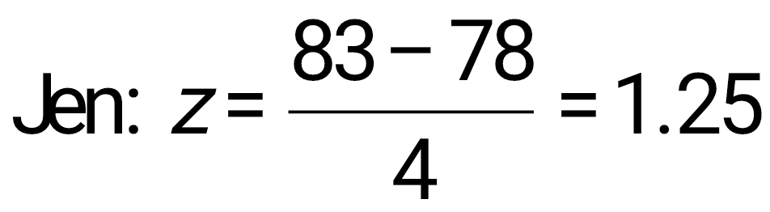
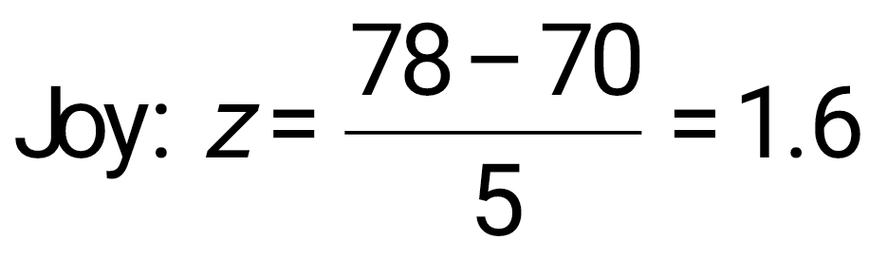
Example: Comparing with z-Scores
Solution
Calculate the z-scores:
Since Joy’s z-score is higher, she was positioned relatively higher within her class than Jen was within her class.

Slide 9
Percentiles
When you take a standardized test taken by larger numbers of students, your raw score is usually converted to a percentile score, which is defined on the next slide.

Slide 10
Percentiles
If approximately n percent of the items in a distribution are less than the number x, then x is the nth percentile of the distribution, denoted P_{n}.

Slide 11
Example: Percentiles
The following are test scores (out of 100) for a particular math class.
44 56 58 62 64 64 70 72
72 72 74 74 75 78 78 79
80 82 82 84 86 87 88 90
92 95 96 96 98 100
Find the fortieth percentile.

Slide 12
Example: Percentiles
Solution
The 40th percentile can be taken as the item below which 40 percent of the items are ranked. Since 40 percent of 30 is (.40)(30) = 12, we take the thirteenth item, or 75, as the fortieth percentile.

Slide 13
Deciles and Quartiles
Deciles are the nine values (denoted D₁, D₂,…, D₉) along the scale that divide a data set into ten (approximately) equal parts, and quartiles are the three values (Q₁, Q₂, Q₃) that divide the data set into four (approximately) equal parts.

Slide 14
Example: Deciles
The following are test scores (out of 100) for a particular math class.
44 56 58 62 64 64 70 72
72 72 74 74 75 78 78 79
80 82 82 84 86 87 88 90
92 95 96 96 98 100
Find the sixth decile.

Slide 15
Example: Percentiles
Solution
The sixth decile is the 60th percentile. Since 60 percent of 30 is (.60)(30) = 18, we take the nineteenth item, or 82, as the sixth decile.

Slide 16
Finding Quartiles
For any set of data (ranked in order from least to greatest):
The second quartile, Q₂, is just the median.
The first quartile, Q₁, is the median of all items below Q₂.
The third quartile, Q₃, is the median of all items above Q₂.

Slide 17
Example: Quartiles
The following are test scores (out of 100) for a particular math class.
44 56 58 62 64 64 70 72
72 72 74 74 75 78 78 79
80 82 82 84 86 87 88 90
92 95 96 96 98 100
Find the three quartiles.

Slide 18
Example: Percentiles
Solution
The two middle numbers are 78 and 79 so
Q₂ = (78 + 79)/2 = 78.5.
There are 15 numbers above and 15 numbers below Q₂, the middle number for the lower group is
Q₁ = 72, and for the upper group is
Q₃ = 88.

Slide 19
The Box Plot
A box plot, or box-and-whisker plot, involves the median (a measure of central tendency), the range (a measure of dispersion), and the first and third quartiles (measures of position), all incorporated into a simple visual display.

Slide 20
The Box Plot
For a given set of data, a box plot (or box-and-whisker plot) consists of a rectangular box positioned above a numerical scale, extending from Q₁ to Q₃, with the value of Q₂ (the median) indicated within the box, and with “whiskers” (line segments) extending to the left and right from the box out to the minimum and maximum data items.

Slide 21
Example:
Construct a box plot for the weekly study times data shown below.
1 | 5 8
2 | 0 7 8 9 9
3 | 2 6 6 7
4 | 0 2 2 7 9
5 6 | 1 5 6 6

Slide 22
Example:
Solution
The minimum and maximum items are 15 and 66.
15
28.5
36.5
48
66
Q₁
Q₂
Q₃

